Slide 1

Handling Exceptions
By
Krishnaprakash N
GBS IT Innovation Quality

Slide 2
Handling Exceptions with PL/SQL
An exception is an identifier in PL/SQL that is raised during execution
How is it raised?
  An oracle error occurs
  you raise it explicitly
How do you handle it?
  Trap it with a handler
  Propagate it to the calling environment

Slide 3
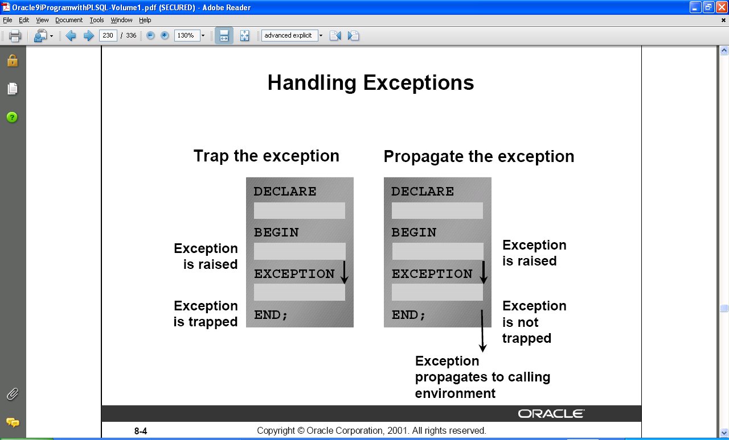
Handling Exceptions

Slide 4
Exception Types
Implicitly raised
  Predefined Oracle Server
  Nonpredefined Oracle Server
Explicitly raised
  User-defined

Slide 5
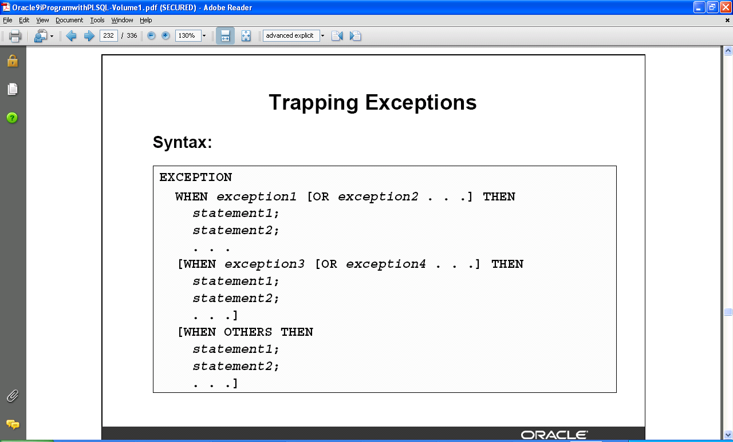
Trapping Exceptions

Slide 6
Trapping Exceptions Guidelines
The EXCEPTION keyword starts exception-handling section.
Several exception handlers are allowed.
Only one handler is processed before leaving the block.
WHEN OTHERS is the last clause.

Slide 7
Trapping Predefined Oracle Server Errors
Reference the standard name in the exception handling routine. Sample predefined exceptions:
  NO_DATA_FOUND
    No Data Found
  TOO_MANY_ROWS
    A SELECT..INTO statement matched more than one row.
  INVALID_CURSOR
    Illegal cursor operation
  ZERO_DIVIDE
    Division by zero
  DUP_VAL_ON_INDEX
    Unique constraint violated
  CURSOR_ALREADY_OPEN
    Attempt to open a cursor that is already open
  VALUE_ERROR
    Truncation , arithmetic or conversion error.

Slide 8
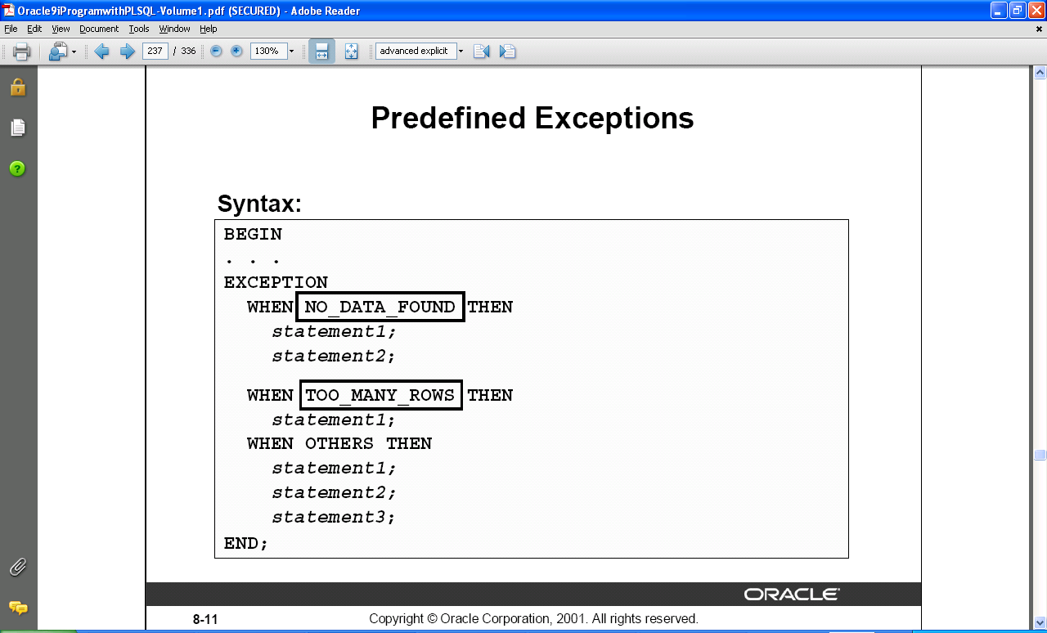
Predefined Exceptions

Slide 9
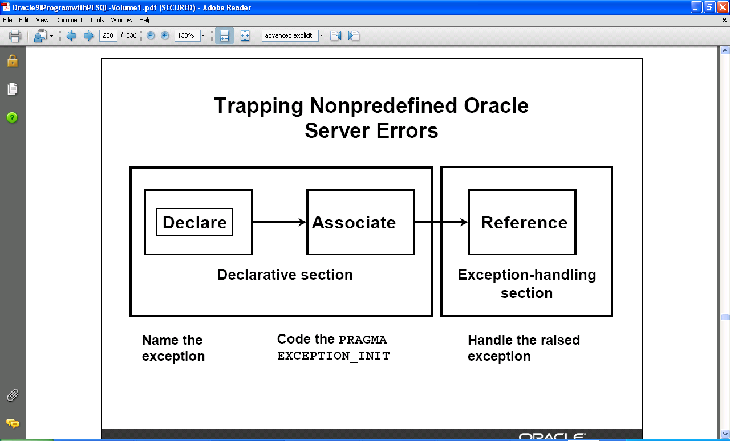
Trapping Nonpredefined Oracle Server Errors

Slide 10
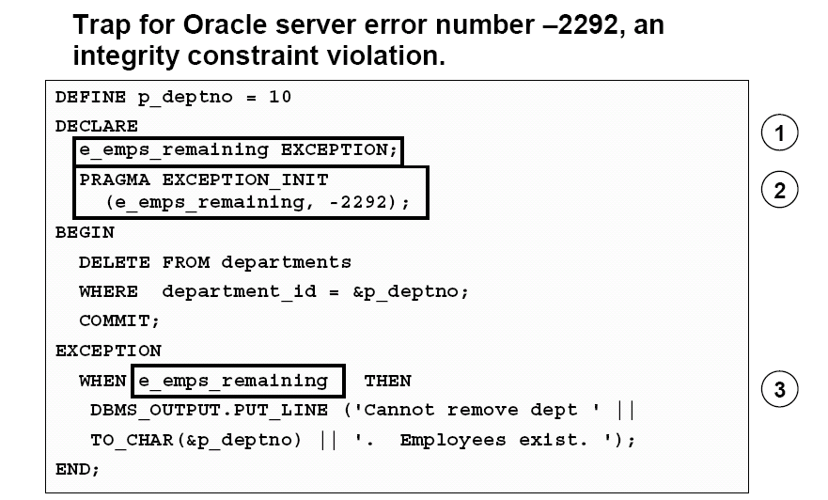
Nonpredefined Error

Slide 11
Functions For Trapping Exceptions
SQLCODE
  Returns the numeric value for the error code
SQLERRM
  Returns the message associated with the error number.

Slide 12
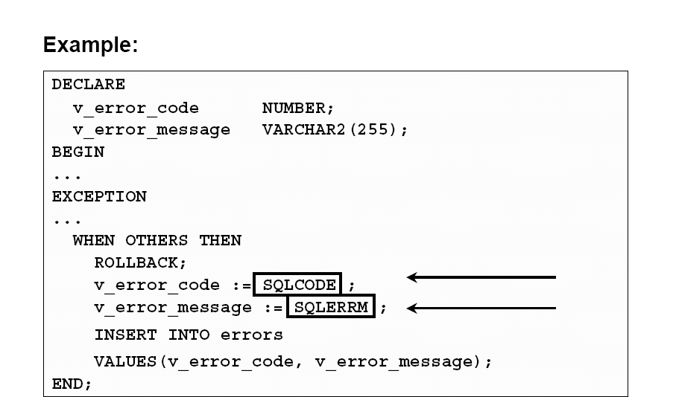
Functions For Trapping Exceptions

Slide 13
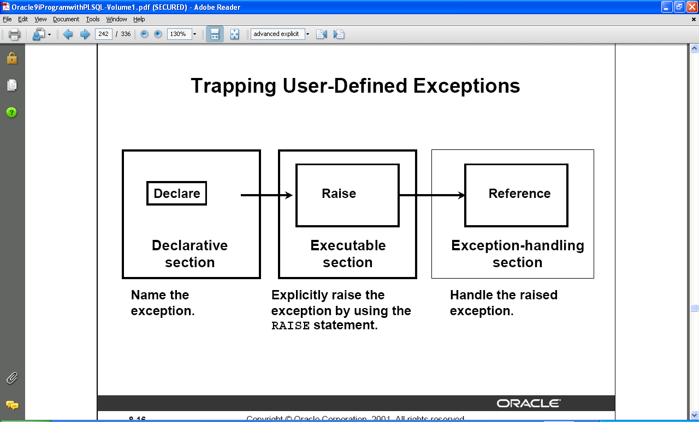
Trapping User-Defined Exceptions

Slide 14
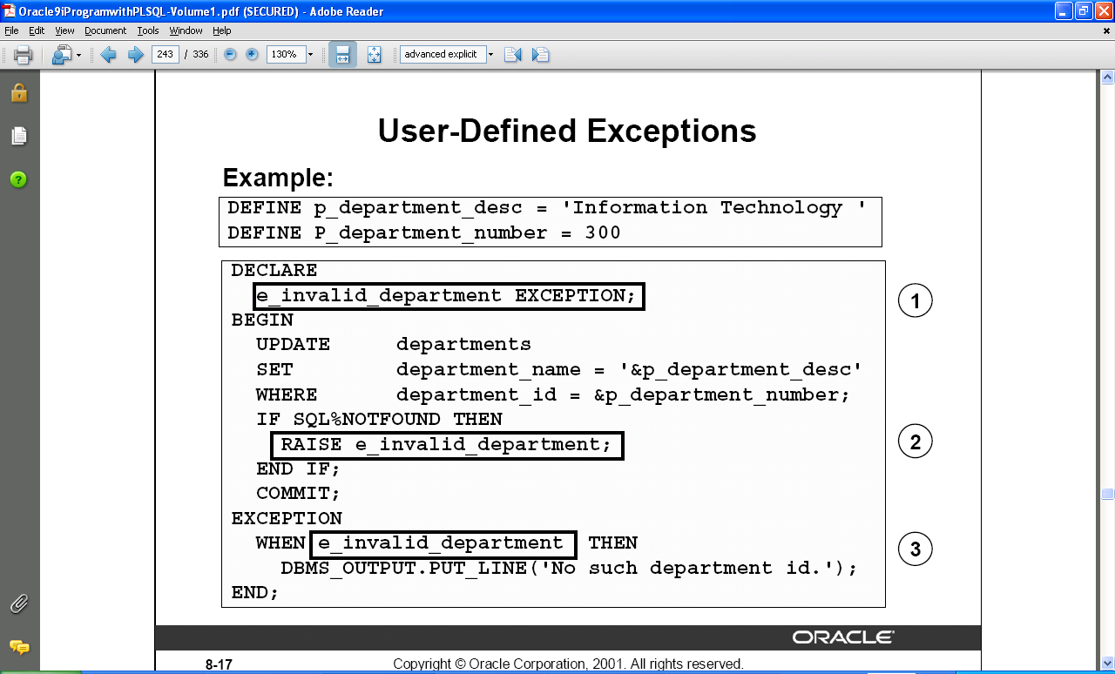
User Defined Exceptions

Slide 15
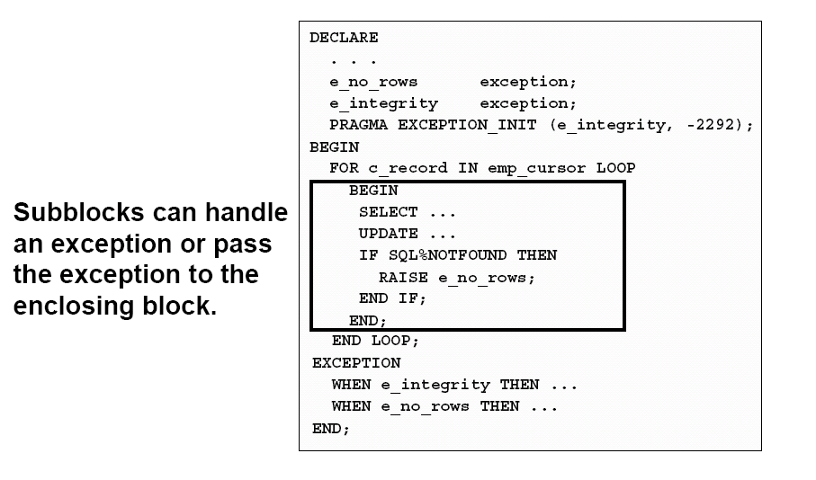
Propagating Exceptions

Slide 16
The RAISE_APPLICATION_ERROR Procedure
Syntax :
raise_application_error (error_number,message[, {TRUE | FALSE}]);
You can use this procedure to issue user-defined error messages from
stored subprograms.
You can report errors to your application and avoid returning unhandled
exceptions.
Used in two different places:
  Executable section
  Exception section
error_number
  User-specified number for the exception between -20000 and -20999

Slide 17
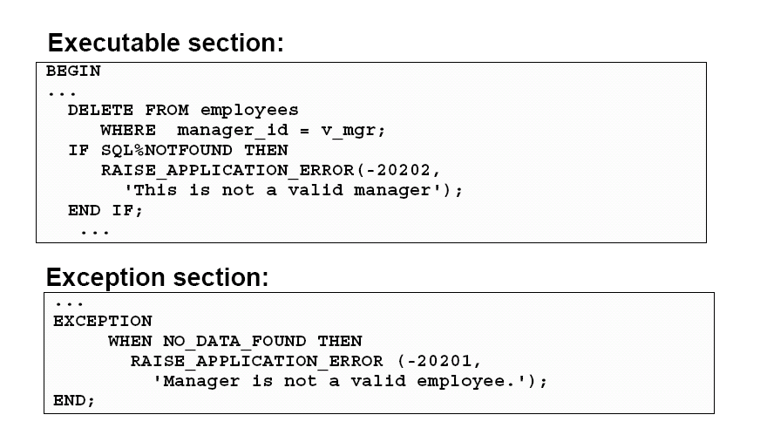
Raise_Application_Error

Slide 18
Thank You

